Slide 1

Get going with Logbook of The World
Gary Hinson ZL2iFB
Notes:
This presentation was originally prepared by ZL2iFB for the NZART Annual Conference in Napier in June 2021.
The objective is to encourage more hams to start using LoTW. That’s all.
The target audience consists of hams who don’t already use LoTW … implying they maybe don’t know about it, find it too intimidating, or simply haven’t got around to it yet.
It outlines and promotes LoTW first, then explains how to register and upload QSOs. It mentions applying for DXCC as an example of the benefits, and ends with a forward-looking perspective on ARRL’s Project X.
This is not an in-depth exploration of the technology behind the PKI system – in fact that’s the only time “PKI” is even mentioned. It is a gentle introduction, not a detailed technical presentation. There are links to further documentation at the end.

Slide 2
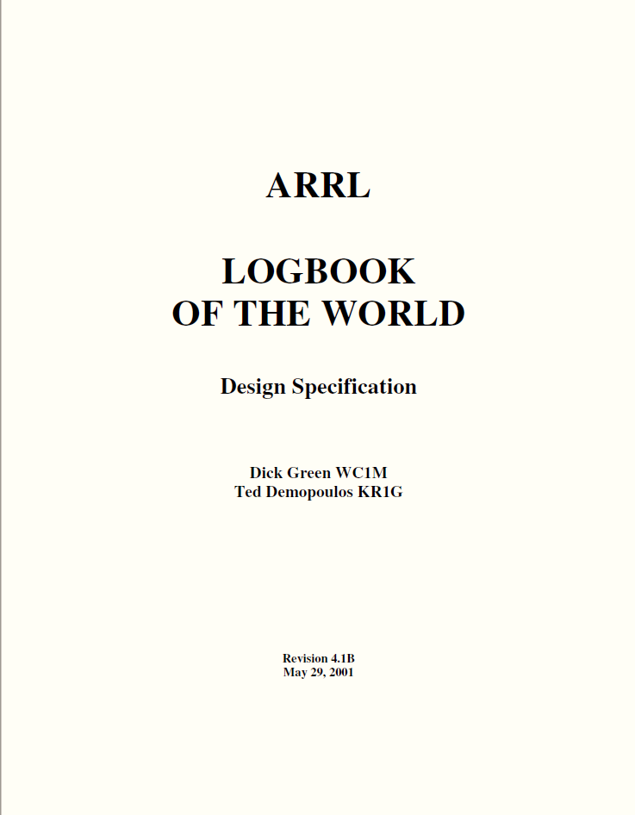
What is Logbook of The World?
2001
Notes:
It’s not really a logbook … but it does cover the whole world.
It was specified and designed around the end of the last millennium.

Slide 3
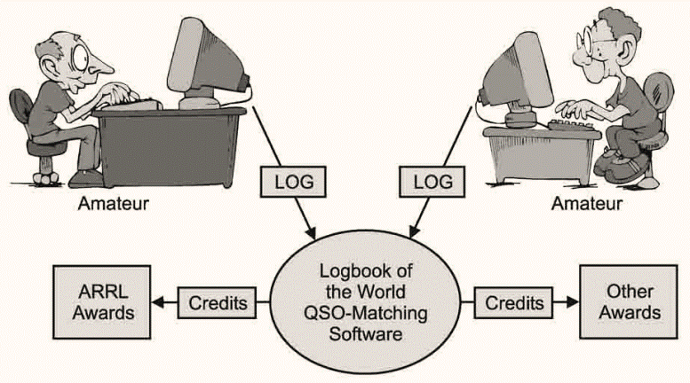
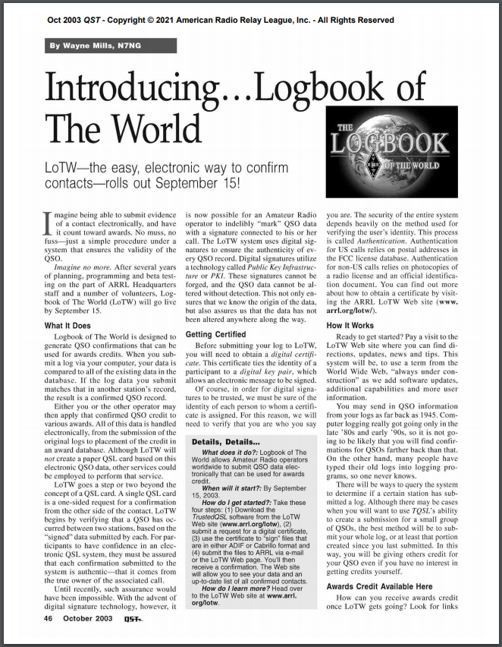
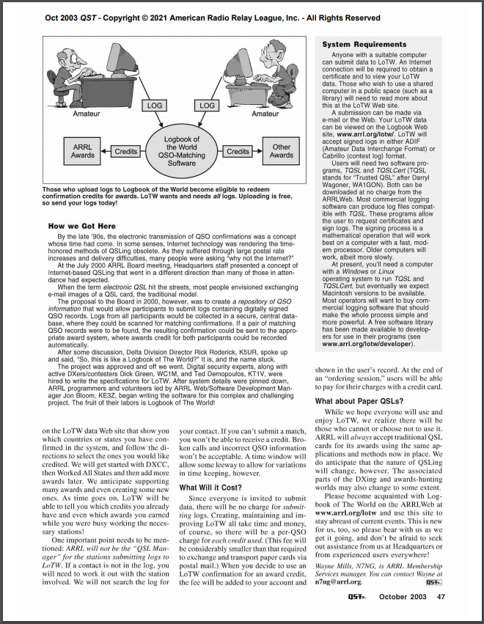
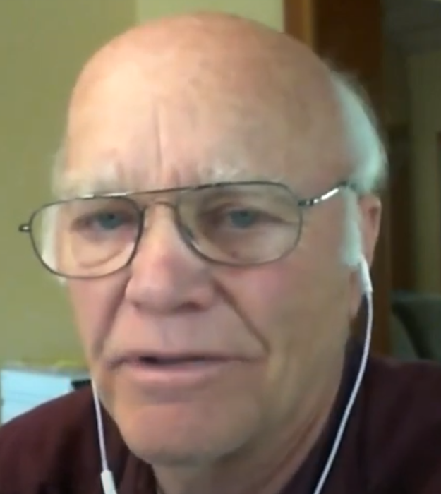
2003
What is Logbook of The World?
Wayne N7NG in 2021
Notes:
Two years after the LoTW specification was published, the LoTW system was ready to launch.
Wayne N7NG wrote this article for ARRL’s QST magazine in October 2003, announcing the new system.
[CLICK]
This diagram from Wayne’s article sums up LoTW.
Notice that it is described as ”QSO-Matching Software” – not a logbook, nor even an online QSL system.

Slide 4
Why bother? What’s in it for me?
“Because it's online, it's faster and cheaper”
Steve W3HF
“I like QSLs too, in the old fashion way, but buro takes forever. Direct sometimes you sent it 2, 3, 4 or more times, each time $2 plus snail mail. LoTW is cheaper and faster.”
Nuno CT2IRY
LoTW makes confirming contacts easier, quicker, cheaper and more trustworthy
“LoTW is much cheaper than direct QSLs and much faster than buro QSLs”
Peg KB9LIE
“I love LoTW as it is much easier and much faster than the old QSL postcards I used until LoTW came in. Probably had a lower response to postcards too.”
Gil W0MN
Notes:
It’s also more credible and trustworthy than most other QSL methods – particularly some of the electronic QSL systems out there.

Slide 5
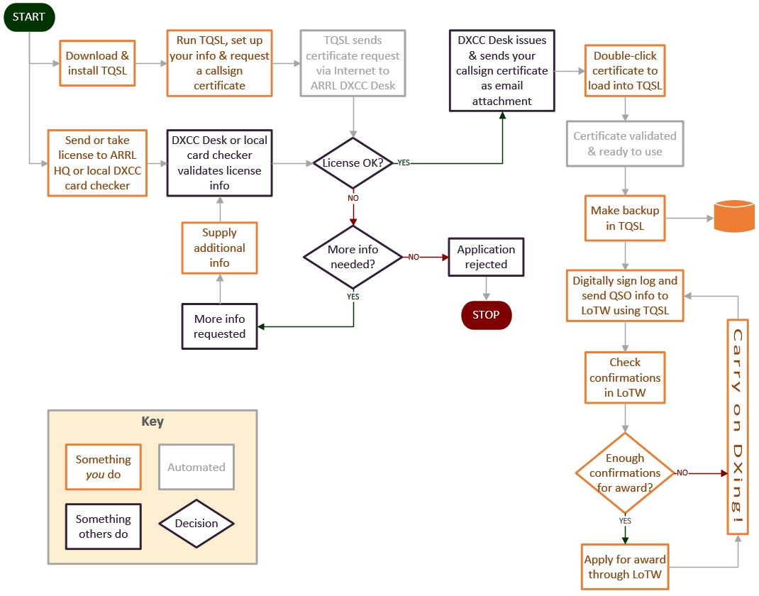
How does it work?
Setup
Use
Notes:
The flow diagram hints at LoTW’s technical complexity … but don’t fret. There are really only two aspects to it:
Setting things up. Although a little daunting, this is a one-time activity.
Using LoTW. Once set up, the routine of using LoTW is quite straightforward.
We’ll explain them both …
[The flow diagram comes from the LoTW New User Guide: there’s a download link at the end of this presentation.]

Slide 6
LoTW setup
Notes:
The next few slides are about setting things up to use LoTW.

Slide 7
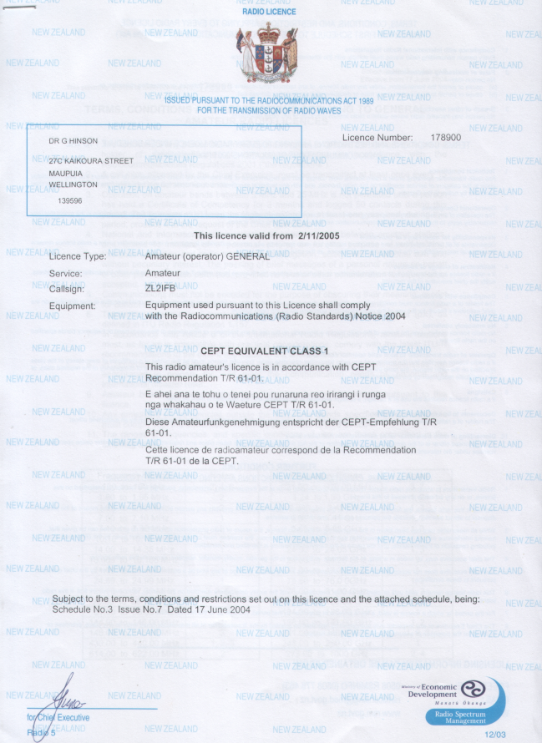
Prerequisites 1 of 3
A valid amateur license
Notes:
For most hams, this is the main formality in joining LoTW.
Simply convince ARRL that you are duly licensed.

Slide 8
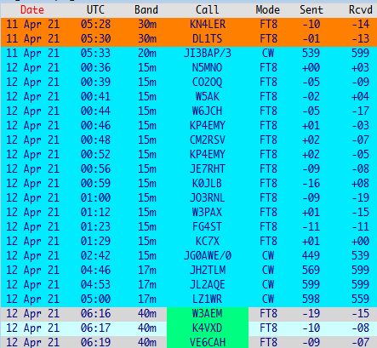
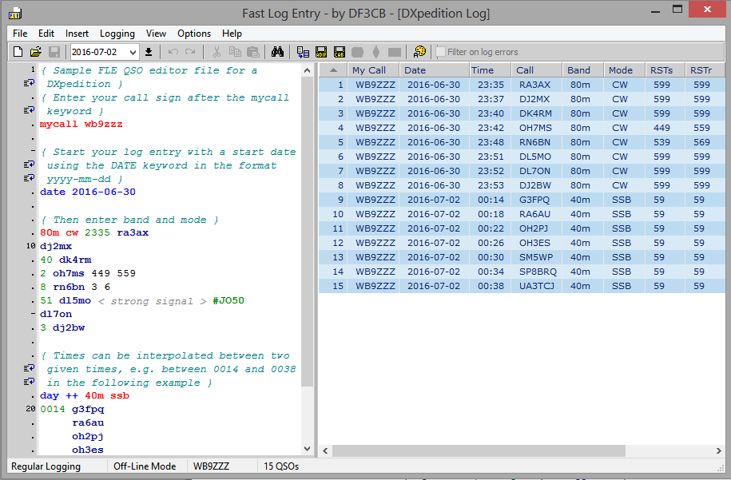
Prerequisites 2 of 3
An electronic log
Notes:
The second prerequisite is straightforward: you need an electronic log. Easy enough if you log your QSOs on a computer … but what If you have a paper log, and actual logbook?
Well, you have choices:
Prepare an electronic log of ALL your QSOs … or the “interesting” ones anyway
Pay someone to type up your logs for you
Don’t worry about historical QSOs: start your electronic log today!
TQSL has a basic QSO editor function if you want to sign and upload just a few individual QSOs.

Slide 9
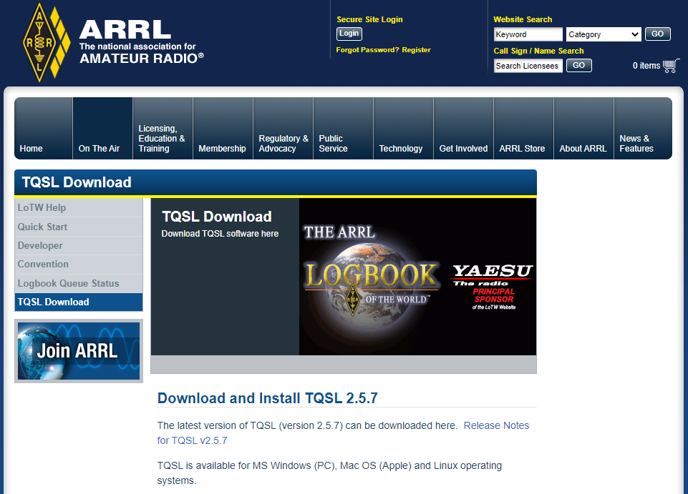
Prerequisites 3 of 3
Trusted QSL app
FREE!
Notes:
The third and final prerequisite is TQSL, a FREE app (application program) from ARRL that processes your electronic log: it appends a digital signature and uploads your signed QSOs to LoTW.
We’ll explain that in a moment … and there are download links at the end of this presentation.

Slide 10
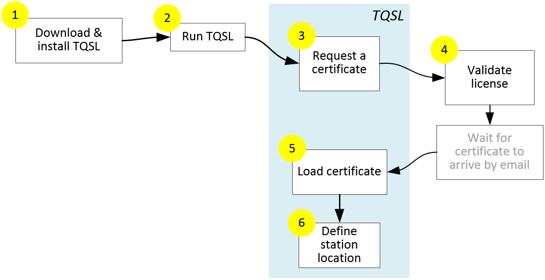
Register
FREE!
Notes:
‘Registering’ for LoTW is the process of proving to ARRL that you are the owner of a duly-licensed callsign.
It’s a bit like applying to the government for a passport, only simpler, quicker and MUCH cheaper.
[Step through the flow diagram]
US ham licenses are verified through the FCC.
Outside the US, ham licenses can often be checked and validated by ARRL-authorized DXCC field checkers, or this can be done via emails to ARRL HQ using scanned paperwork.
[CLICK]
Like TQSL, registering for LoTW is also FREE!

Slide 11
Using LoTW
Notes:
OK, having registered for LoTW and received your first “callsign certificate”, you have completed the most difficult part of the process.
The rest – actually using LoTW – is straightforward. Trust me, you’ll soon get the hang of it.

Slide 12
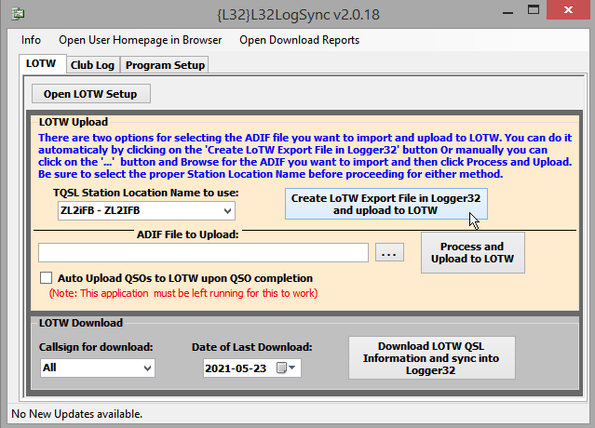
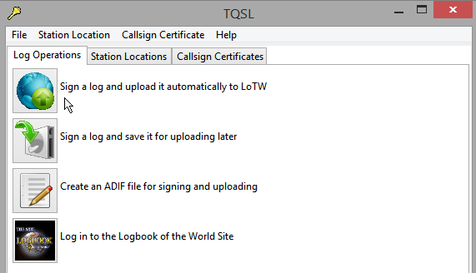
Sign and upload your log
Notes:
TQSL has a function to sign and upload a log file.
[CLICK]
Your logging software may automate this for you, signing and uploading QSOs in batches (maybe with a few clicks).

Slide 13
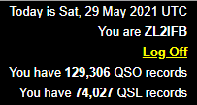
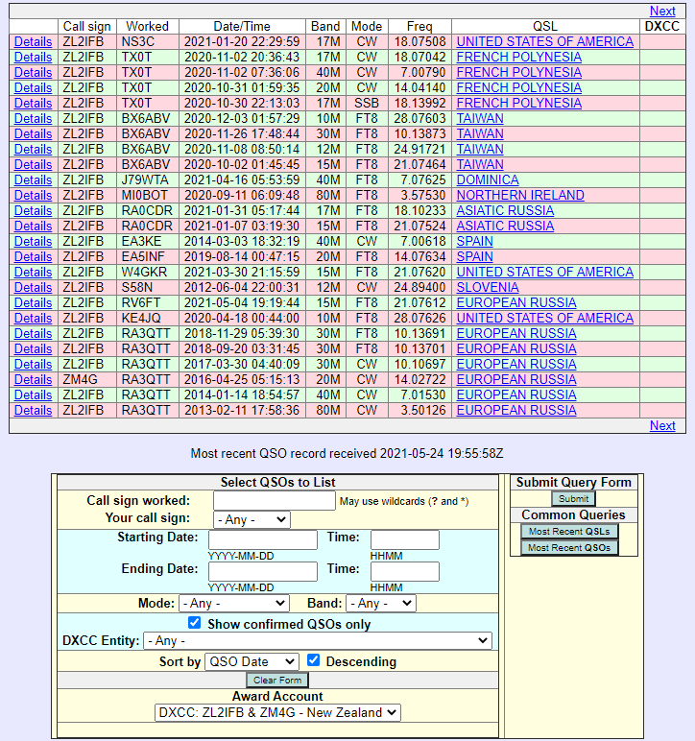
Check confirmations received
57%
Notes:
Having signed and uploaded some QSOs, you will soon see them appear on the LoTW online system.
I can tell from the numbers in the corner of the LoTW screen that more than half of my QSOs have been confirmed on LoTW.

Slide 14
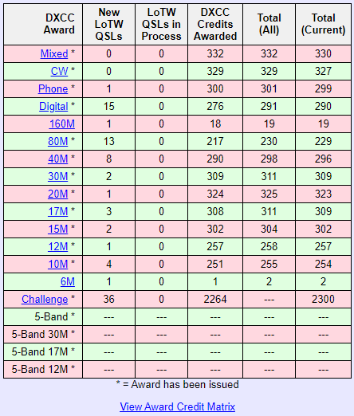
DXCC
Notes:
I can use LoTW confirmations to apply for DXCC. Over 2,000 QSOs have already been credited for DXCC, with 36 new ones available at the time this screenshot was taken. The process of using LoTW-confirmed QSOs for DXCC is quick and painless, all online with no paperwork … but there is a charge to cover the DXCC administration, certificates, plaques etc.

Slide 15
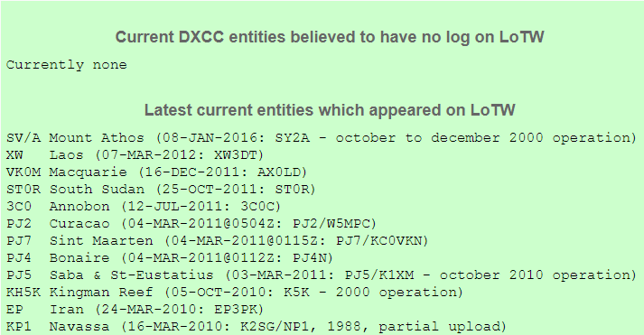
DXCC
www.hb9bza.net/lotw-users-list/8-lotw/20-lotw-missing
Notes:
Logs from every one of 340 current DXCC entities have been uploaded to LoTW – in other words, it is possible to get to #1 Honor Roll purely using LoTW confirmations.
Going forward, it is highly likely that any legitimate operation from a rare DXCC entity will be expected by the ham community at large to upload its log to LoTW at some point. To put that another way, hams are likely to question the legitimacy of any rare DXCC operation that does not upload its log to LoTW, implying that they have failed to persuade the DXCC desk that the operation was duly authorized.
Major DXpedition sponsors often specify LoTW uploads as a condition of their funding.

Slide 16
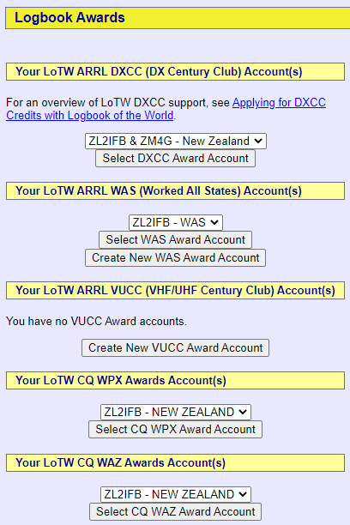
Other awards
Notes:
The list of awards available through LoTW is very short, right now – just these 5 … but we’ll see how that goes.

Slide 17
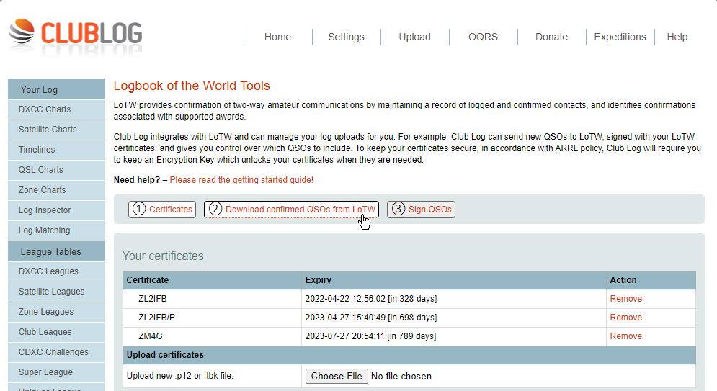
Synchronise your log
FREE!
Notes:
Logging apps can record QSOs that have been confirmed on LoTW, and perhaps submitted and granted for DXCC and other awards. Club Log, for instance, incorporates an easy-to-use LoTW synch function, so you can update your shack log’s LoTW and DXCC status via Club Log.
<CLICK> to see the process

Slide 18
Synchronise your log
18
Notes:
Club Log can grab your LoTW confirmations and DXCC info through a system-to-system link, updating your log and statistics in Club Log.
Logging software such as Logger32 can then connect to Club Log to grab the same information and update your shack log and statistics.
[This may seem long-winded but it is actually easier and quicker than getting the information directly from LoTW to your shack log, due to the way the LoTW system was programmed ~20 years ago.]

Slide 19
The future
2022+
Notes:
… how might things change in future?

Slide 20

X
Notes:
ARRL’s “Project X” was announced by the new ARRL CEO David Minster NA2AA in a video interview with Tim K3LR in December 2020 (www.youtube.com/watch?v=5bKv6InXAkg&t=1138s).
As described by the CEO, Project X is an ambitious ARRL project to completely redesign LoTW (‘LoTW 2.0’) plus update the back-end database systems used to administer LoTW confirmations and awards such as DXCC plus procedural changes at ARRL HQ. It will be a costly multi-year project. The ARRL Logbook Committee is working on it.
Project X may include changes such as:
Migration to the cloud;
Migrating TQSL to a browser-based function, rather than a standalone app;
Adding dashboards with trend graphs etc. illustrating the numbers;
Advanced functionality, such as alerts when sought-after entities are spotted on DX Cluster;
Rule-based and simplified award definitions to facilitate adding new awards;
Mobile device support;
General streamlining and User Interface improvements.
Project X will hopefully incorporate migration and documentation, plus funding for ongoing support, monitoring, management and maintenance as well as routine operations.
However, very little information about the project has escaped the ARRL HQ black hole so far, and questions to ARRL management about the Project X plans and team have gone unanswered. Maybe elves are busy in the cave. Maybe all will be revealed soon … or maybe this was just “vapourware”, an overambitious announcement by an overexcited CEO? We shall see.

Slide 21
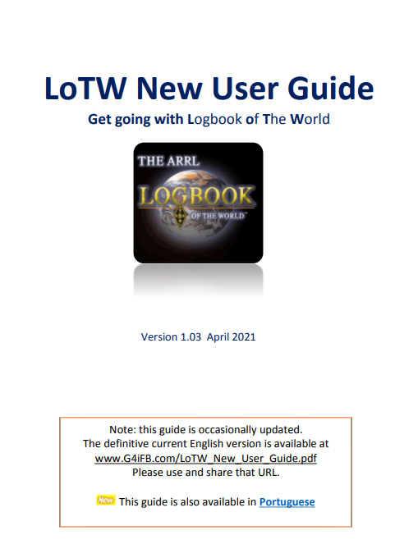
Questions?
Notes:
Is that reasonably clear and straightforward?
There’s quite a bit more information in the LoTW New User Guide, available from the ARRL website (link on the next slide).
If ~30 pages is too much for you, there are quick start guides written by Dave AA6AQ (a programmer who worked on LoTW for a couple of years) plus help pages accessible through the LoTW website, and yet more help within TQSL, Club Log, Fast Log Entry and other logging programs etc.
There’s even an office ARRL “email reflector” (group) for LoTW users …

Slide 22
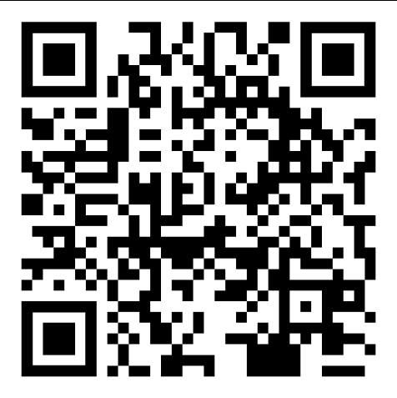
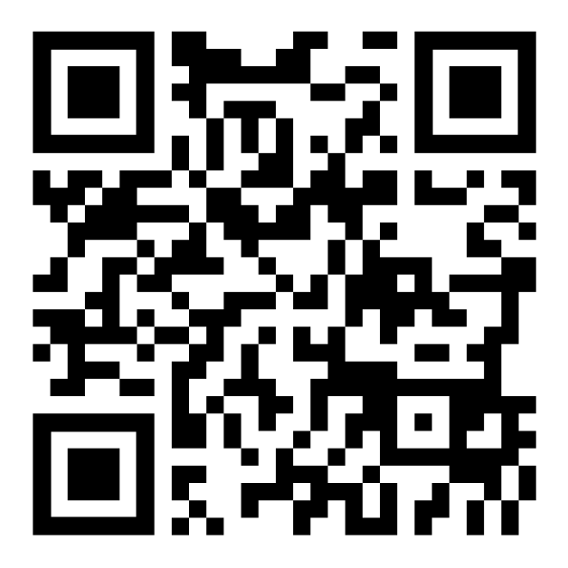
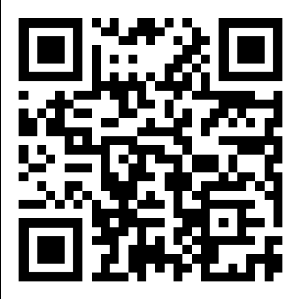
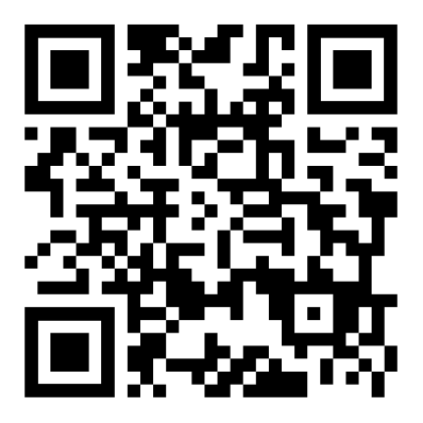
LoTW New User Guide
TQSL
Fast Log Entry
LoTW reflector
Notes:
[Leave this slide on the screen at the end for anyone who wants to scan the QR codes on their smartphones … and/or print it out and post it on noticeboards at the venue.]

